Slide 1


Recall
Cristi Bramer MDHHS Vaccine Preventable Disease Epidemiologist
John Harwood, Region 2 MCIR Coordinator
Bea Salada, MDHHS MCIR Coordinator

Slide 2
Agenda
Welcome/Introductions
Impact of COVID-19 on Immunizations
Cristi Bramer, MDHHS Vaccine Preventable Disease Epidemiologist
The Basics of Using MCIR Reminder/Recall
John Harwood, Region 2 MCIR Coordinator

Slide 3
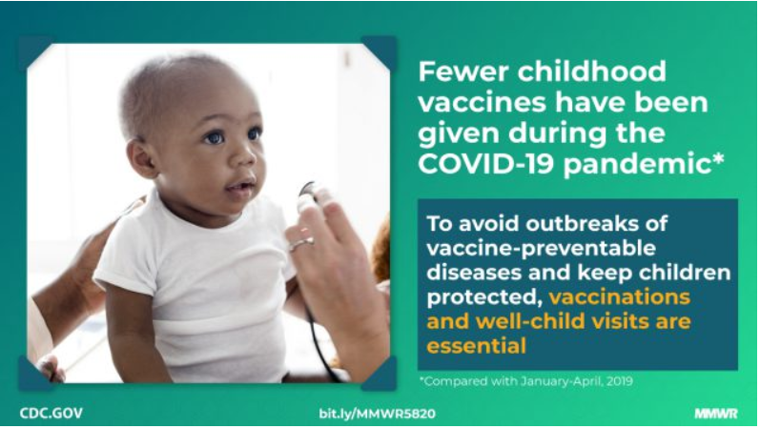
Impact of COVID-19 on Immunizations: National Perspective from CDC’s Morbidity and Mortality Weekly Reports
Effects of the COVID-19 Pandemic on Routine Pediatric Vaccine Ordering and Administration — United States, 2020
Decline in Child Vaccination Coverage During the COVID-19 Pandemic — Michigan Care Improvement Registry, May 2016–May 2020
Published May 15, 2020
Substantial reduction in VFC-funded pediatric vaccine ordering
Decline in vaccine administration among children
Published May 22, 2020
Up-to-date series coverage at milestone ages for children less than 2 years of age have declined
http://dx.doi.org/10.15585/mmwr.mm6920e1
Notes from the Field: Rebound in Routine Childhood Vaccine Administration Following Decline During the COVID-19 Pandemic — New York City, March 1–June 27, 2020
Published May 22, 2020
Vaccine administration increased among persons aged <24 months starting the week of April 19–25, as the number of new COVID-19 cases declined ad returned to comparable levels in May
http://dx.doi.org/10.15585/mmwr.mm6930a3
http://dx.doi.org/10.15585/mmwr.mm6919e2external icon
Notes:
Routine vaccines and ensuring patients are up-to-date is crucial to protect patients and protect communities from vaccine-preventable disease
Risk of VPD-outbreaks are very concerning as coverage rate estimates have declined
As social distancing relaxes, this concern is even greater
Many global programs for polio and measles have been suspended
COVID-19 reminds us how global viruses are
Vaccines can prevent co-infections and COVID-19 complications by reducing risk of secondary infections
Also keeping in mind flu season this year - a crucial focus locally and nationally
Enhance efforts to protect against flu in the upcoming season
Vaccines reduce burden on the healthcare system by preventing hospitalizations

Slide 4
Percent Change in Doses Administered in 2020 Compared To the 2018-2019 Average by Age Group And Month, MCIR

Slide 5
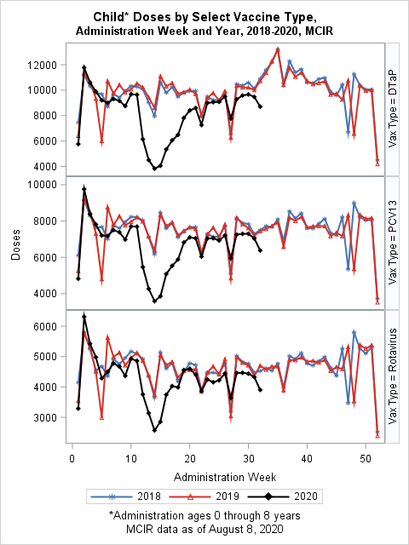
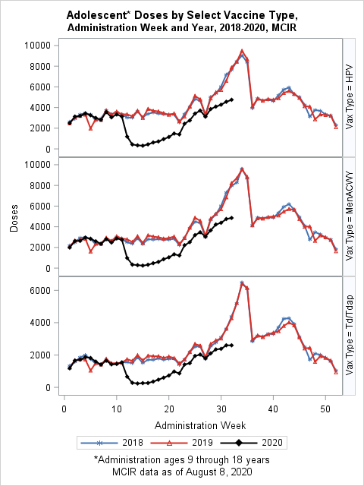
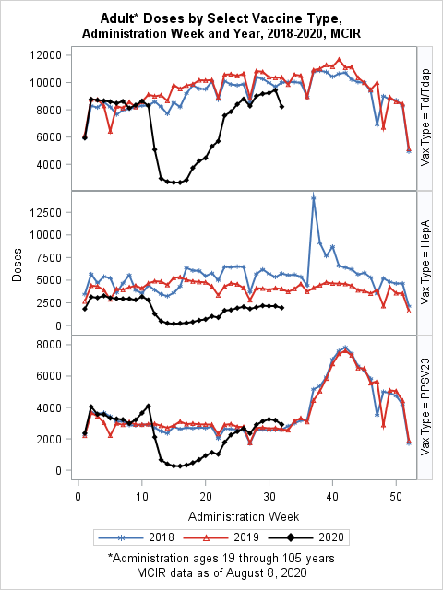
Doses Administered by Age

Slide 6
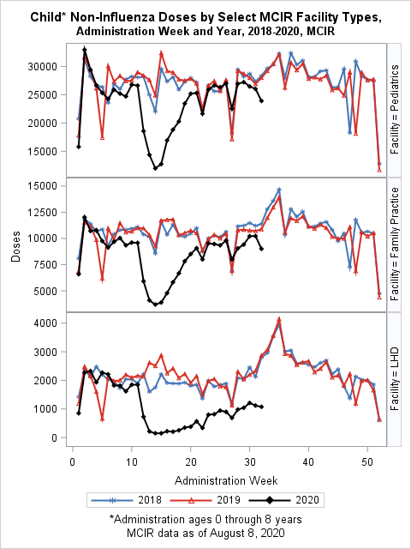
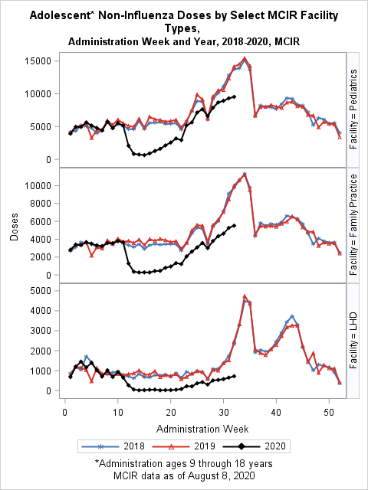
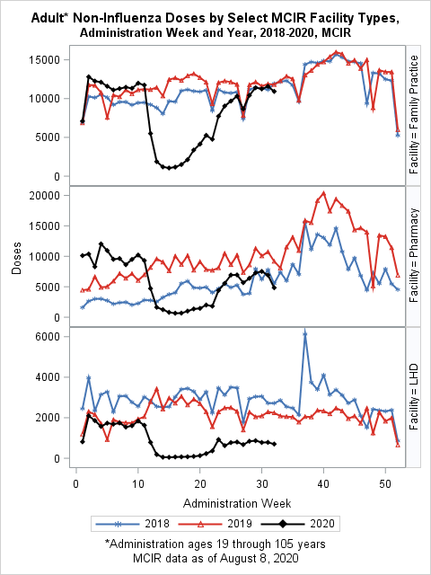
Doses Administered by Age and MCIR Facility Type

Slide 7
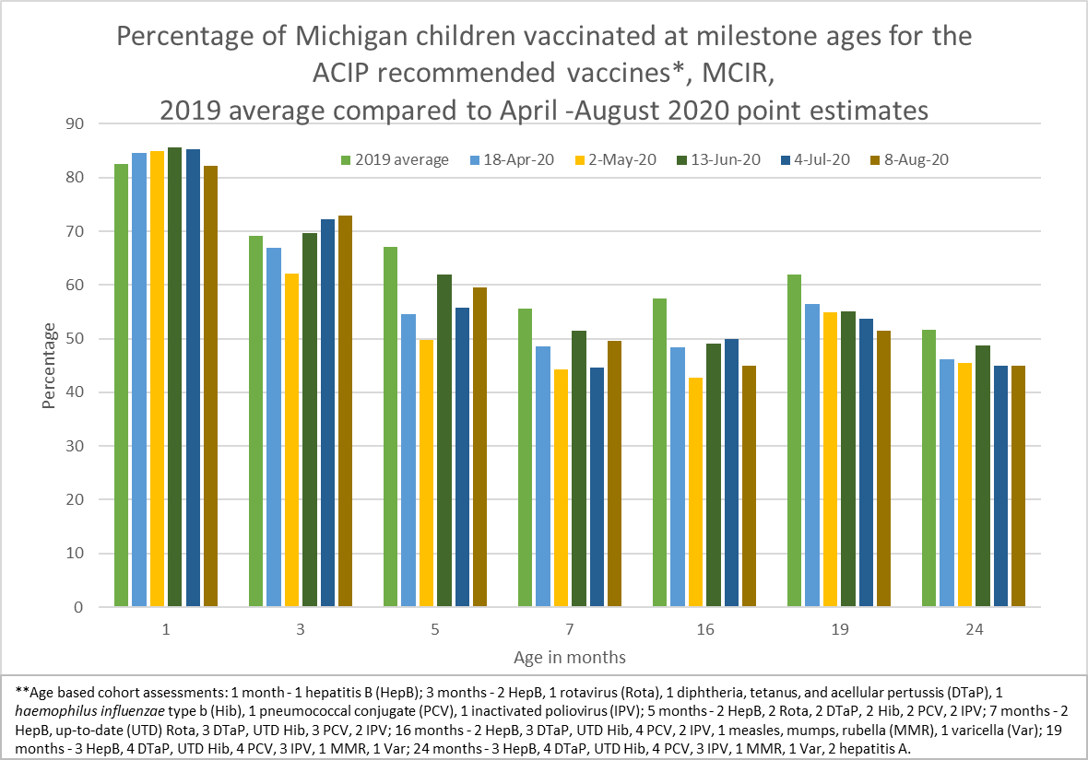

Slide 8
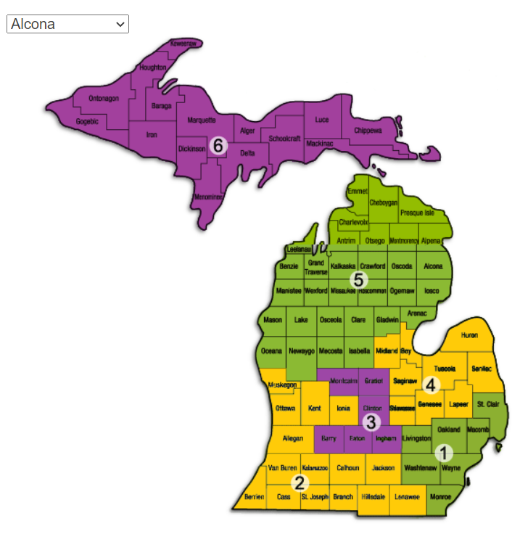
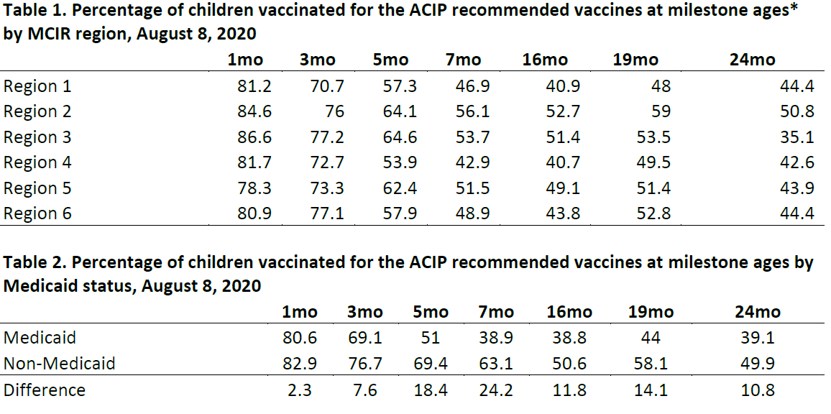
Vaccination Coverage in Children less than 2 years at Milestone Ages
**Age based cohort assessments: 1 month - 1 hepatitis B (HepB); 3 months - 2 HepB, 1 rotavirus (Rota), 1 diphtheria, tetanus, and acellular pertussis (DTaP), 1 haemophilus influenzae type b (Hib), 1 pneumococcal conjugate (PCV), 1 inactivated poliovirus (IPV); 5 months - 2 HepB, 2 Rota, 2 DTaP, 2 Hib, 2 PCV, 2 IPV; 7 months - 2 HepB, up-to-date (UTD) Rota, 3 DTaP, UTD Hib, 3 PCV, 2 IPV; 16 months - 2 HepB, 3 DTaP, UTD Hib, 4 PCV, 2 IPV, 1 measles, mumps, rubella (MMR), 1 varicella (Var); 19 months - 3 HepB, 4 DTaP, UTD Hib, 4 PCV, 3 IPV, 1 MMR, 1 Var; 24 months - 3 HepB, 4 DTaP, UTD Hib, 4 PCV, 3 IPV, 1 MMR, 1 Var, 2 hepatitis A.

Slide 9
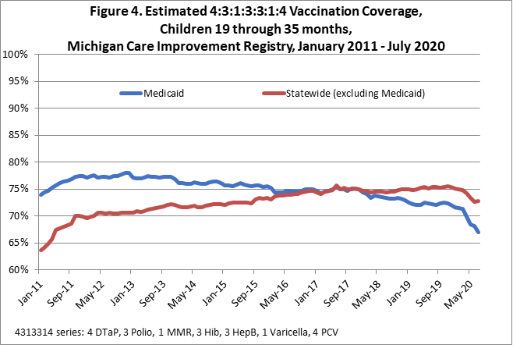
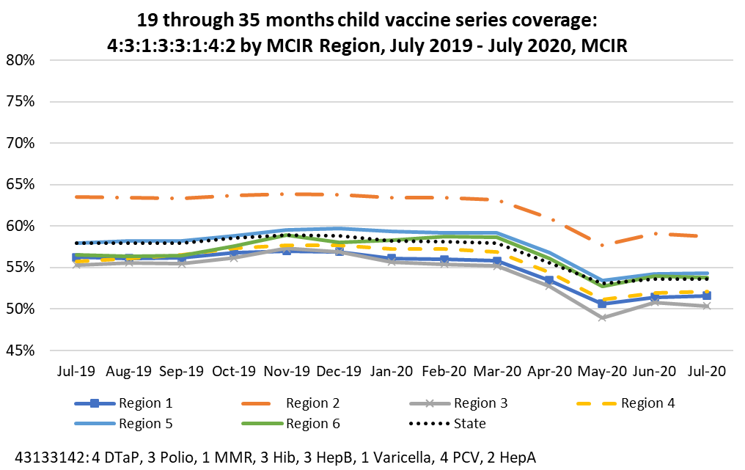
Impact on Vaccination Coverage in Children
4313314 coverage was 70.1% in July
73.8% coverage in March 2020

Slide 10
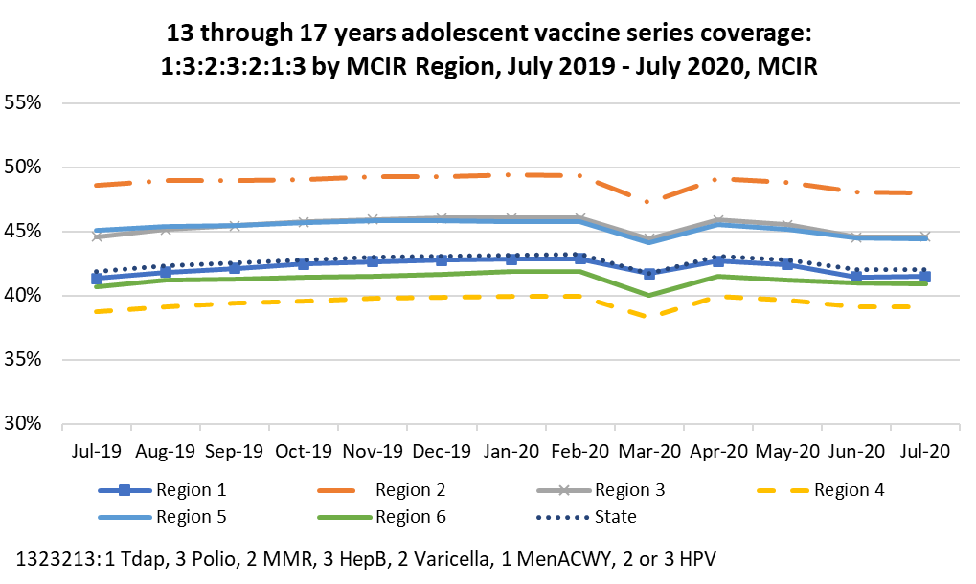
Adolescent Vaccination Coverage

Slide 11
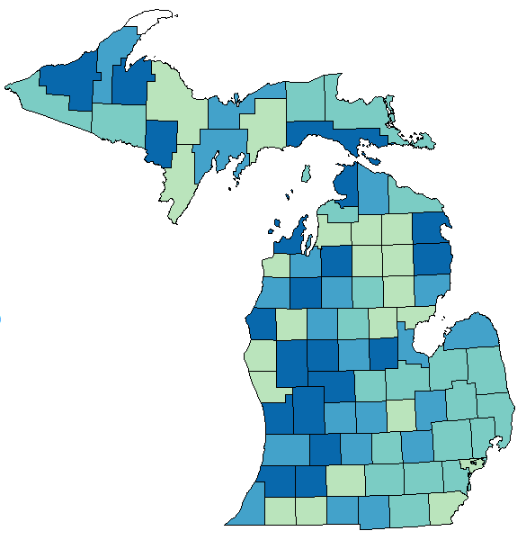
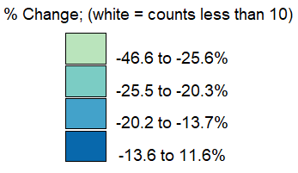
Percent Change in Doses Administered Across the Lifespan in January – July 2020 Compared to the 2018-2019 Average by County, MCIR

Slide 12
The Basics of MCIR Reminder/Recall
Reminder
Specific Age Ranges
Recall
Options are flexible
Only pulls those overdue for vaccines
Notes:
Reminder/Recall is among several evidence-based strategies that can be used to maintain and/or increase your immunization coverage levels by notifying patients to get back to your office for vaccines
MCIR offers Reminders for vaccines of patients in specific age ranges, as well as Recall, which focuses on patients that are 30 days or more past due for immunizations
We will be covering the basics of running a MCIR reminder, and then a recall. These are both useful tools that you can use to keep your patients from falling too far behind on their immunizations

Slide 13
Things to Keep in Mind About Reminder
Not based on Immunization Assessment, but by Age
Patient Medical Home
Roster vs. Provider ID
Effect of Patient Status
Notes:
If you’re running a REMINDER, there a few things to keep in mind:
The patient will be included in the Reminder based on their age, not on their vaccine eligibility. The reminder will generate with patients at least 6 months younger than the chosen age milestone.
If you were the last office to give a patient vaccines (other than birth dose hep b or flu), you are their immunizing medical home and they will be included in your reminders.
There is a difference if running a Reminder by Roster or Provider ID
Reminders run by Roster are only applicable to sites that are maintaining their roster.
Reminders run by Provider ID will only include your current patients (you are the patient’s immunizing Medical Home)
If patients no longer visit your office or your attempts to contact them are ignored, you are hopefully updating the patient’s status to Moved or Gone Elsewhere or Lost to Follow-up to prevent these records from pulling into a reminder, saving you postage

Slide 14

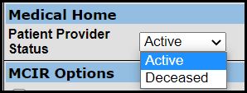
Patient Status
From the patient General Information page click Edit above the patients name.
If you are not the medical home you will only have the option of Active or Deceased.
No action is required.
Notes:
To find the medical home from the patients General Information page click Edit above their name. This will take you to the Edit Person screen where some edits can be made to the patients information.
Under Medical Home, your office’s name should appear. The patient provider status should show Active.
If you are not their immunizing medical home in MCIR, they will not be included in your Reminder/Recalls or when assessing your rates.
No further action is required.

Slide 15
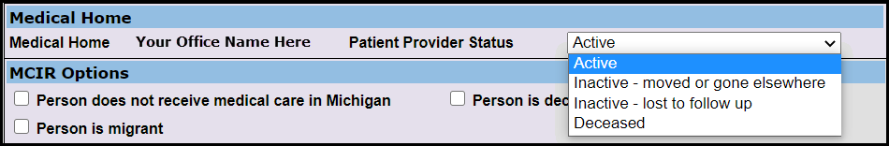
Patient Status
Patient Status should be updated for patients that move, are no longer patients of the office, or are deceased.
Notes:
If patients have moved, no longer visit your office, or your attempts to contact them are ignored, you want to update their Patient Provider Status. Doing so ensures they are not included on reminder/recalls. This is especially important with deceased patients.
Updating Patient Provider Status should be done prior to running a reminder/recall to reduce the number of invalid letters generated.

Slide 16
The MCIR Landing Page
Notes:
The Reminder/Recall box can be found on the MCIR Landing Page
To Run a reminder, you’ll click on the Create Reminder link, taking you to the Reminder Outreach Notices page

Slide 17
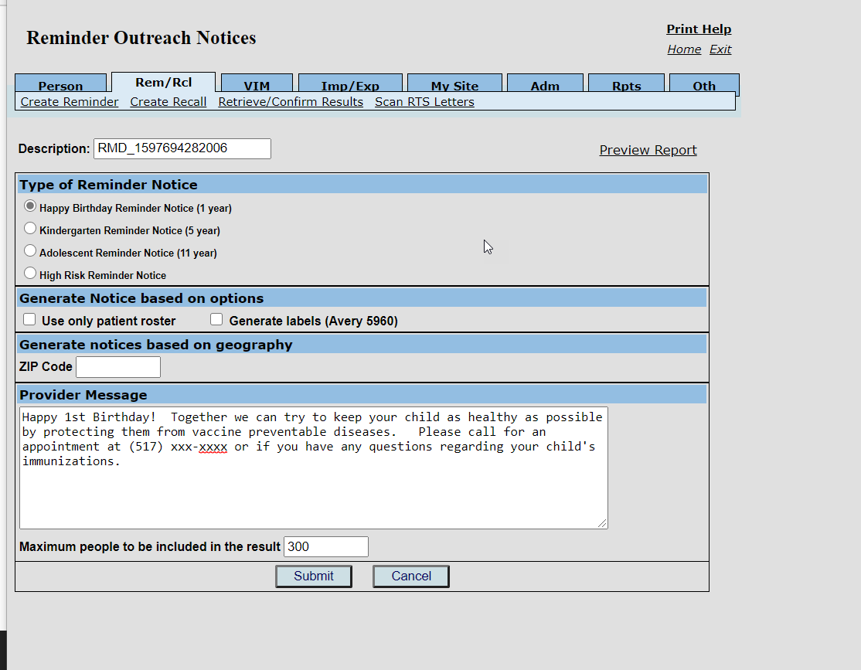
The Reminder Outreach Notices Page
Notes:
The Reminder Outreach Notices page is where you’ll add the parameters that will determine the results of your reminder. These options are targeted to specific age milestones, reminding the parent/guardian that vaccines are coming due.
We’ll review each section to help you understand how to get the most out of reminder.

Slide 18
Reminder Parameters
Change the Description to describe the type of Reminder being run (Ex: My H-Bday Reminder)
Notes:
At the top of the Reminder Outreach Notices page is a description box. You’ll want to replace the generic label with a title that identifies the reminder.
For example, title your notice “My H-Bday Reminder” if you’re running a reminder for the 1 year age range.

Slide 19
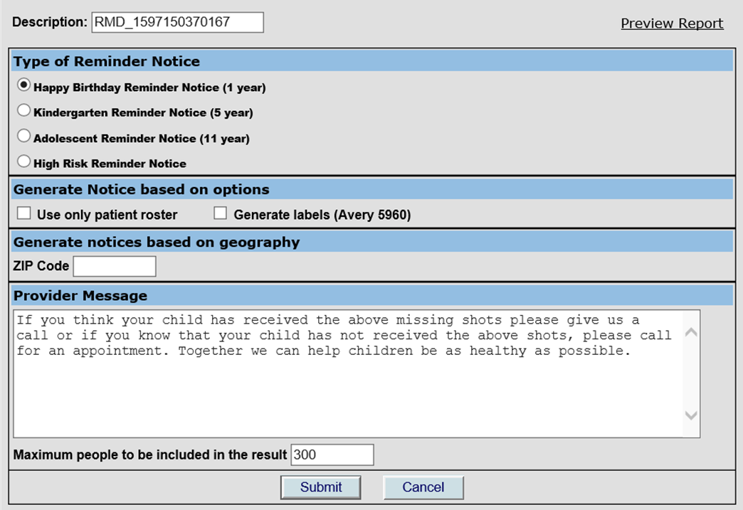
Reminder Parameters
Choose the type of Reminder notice to generate.
Click the Preview button to view each letter
Notes:
It is a requirement for reminder to choose the age milestone you want to target.
A High Risk Reminder Notice may be chosen to target those needing the flu vaccine due to increased risk of complications from influenza. This is based on a patient being previously marked as High Risk in there record.

Slide 20
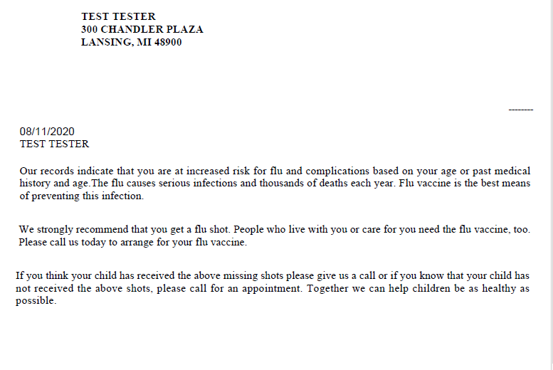
The Reminder Letter – High Risk Reminder Notice
Notes:
Click the Preview button to view the letter.
Here is the High Risk Reminder

Slide 21
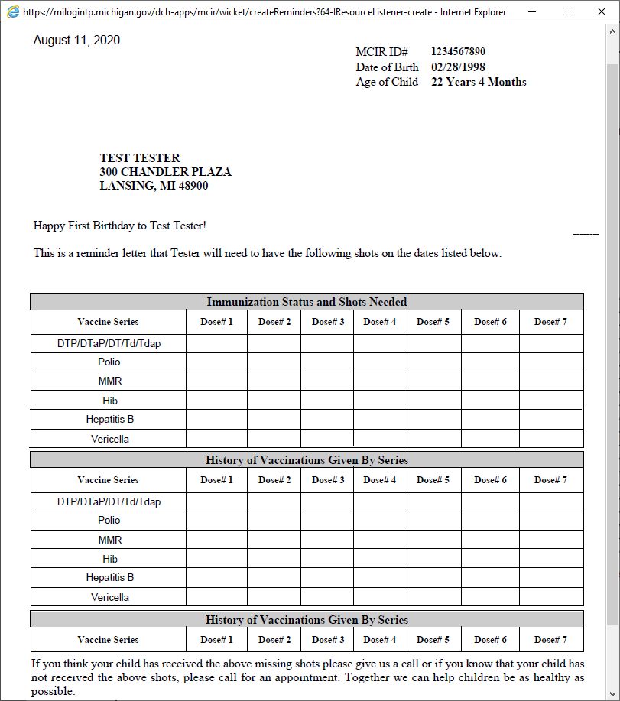
The Reminder Letter – Happy Birthday Reminder Notice (1 year)
Notes:
Here is the Happy Birthday 1yr Reminder

Slide 22
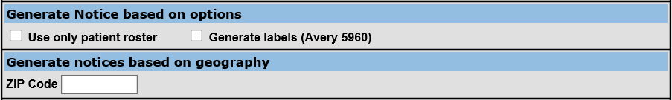
Reminder Parameters
Only choose Patient Roster if it’s being maintained
Labels can be generated to use on postcards
Reminder can be run for patients living in a specific zip code
Notes:
Options can be chosen or left blank

Slide 23
Reminder Parameters
Add a Provider Message including your office name and phone number
Type the maximum number of reminder letters to generate
Choose Submit to review a pop-up confirming the reminder parameters
Notes:
Be sure to add your Office Name and phone number to your provider message, keeping it under the 260 character limit.
Add the number of reminder letters that you feel is manageable, then click the Submit button to review your reminder parameters.

Slide 24
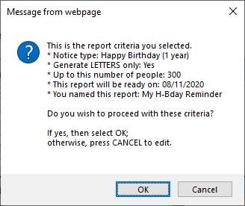
Reminder Parameter Review
Review the pop-up showing your reminder parameters, then click OK to Submit and return to the MCIR Landing Page
Click Cancel if changes need to be made to the parameters
Notes:
If everything looks good on the reminder parameter review pop-up that appears, click OK.
If changes need to be made before submitting, click Cancel to make the changes, then Submit to review again before clicking OK.

Slide 25
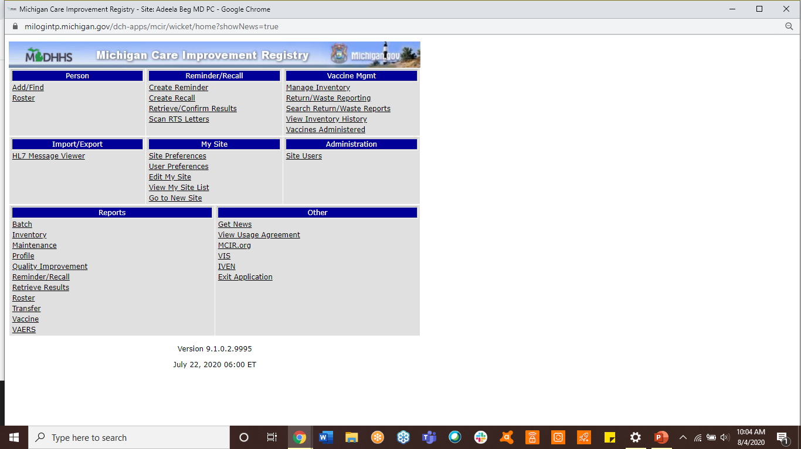
Retrieving Reminder/Recall Results
After submitting the report, you’re taken back to the MCIR Landing Page
To see if the report is ready, click the Retrieve/Confirm Results link in the Reminder/Recall box to view the Reminder/Recall Runs Page
Notes:
The Results for a Reminder or Recall notice will need to be retrieved from the Reminder/Recall box on the MCIR Landing page, or the Rem/Rcl tab on any other page.
This functions the same way for both notices, so to reduce redundancy here we will cover the Reminder/Recall Runs page following the Recall process.

Slide 26
Things to Keep in Mind About Recall
Overdue criteria
Roster vs. Provider ID
Effect of Patient Status
Vaccine and Age limitations
Notes:
If you’re running a recall, there a few things to keep in mind:
A person must be at least 30 days past due to be included in a recall
If you were the last office to give a patient vaccines (other than birth dose hep b or flu), you are their immunizing medical home and they will be included in your recalls
There is a difference if running a recall by Roster or Provider ID
Recalls run by Roster are only applicable to sites that are maintaining their roster.
Recalls run by Provider ID will only include those patients for whom your office is the Medical Home.
There are vaccine and age limitations when running Recall
Recalls will not include anyone under the age of 6 months
Recalls are limited to the following vaccine series
DTP/DTP/DTaP/DT/Td/Tdap
Polio
MMR
HIB
Hepatitis B
Varicella
Pneumococcal Conjugate
Rotavirus
HPV
Hepatitis A
Seasonal Influenza
Pneumococcal (Adult)
Meningococcal Conjugate (overdue at 12)

Slide 27
The MCIR Landing Page
Notes:
Returning to the MCIR Landing Page, we again look to the Reminder/Recall menu.
Click on the Create Recall link, taking you to the Recall Outreach Notices page.

Slide 28
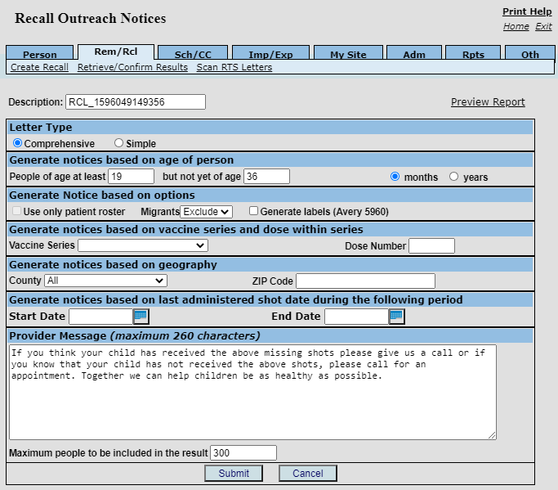
The Recall Outreach Notices Page
Notes:
The Recall Outreach Notices page is where you’ll add the parameters that will determine the results of your recall. These options are flexible, and if you’re not interested in getting too specific, many of them can be left blank.
We’ll review each section to help you understand how to get the most out of recall.

Slide 29
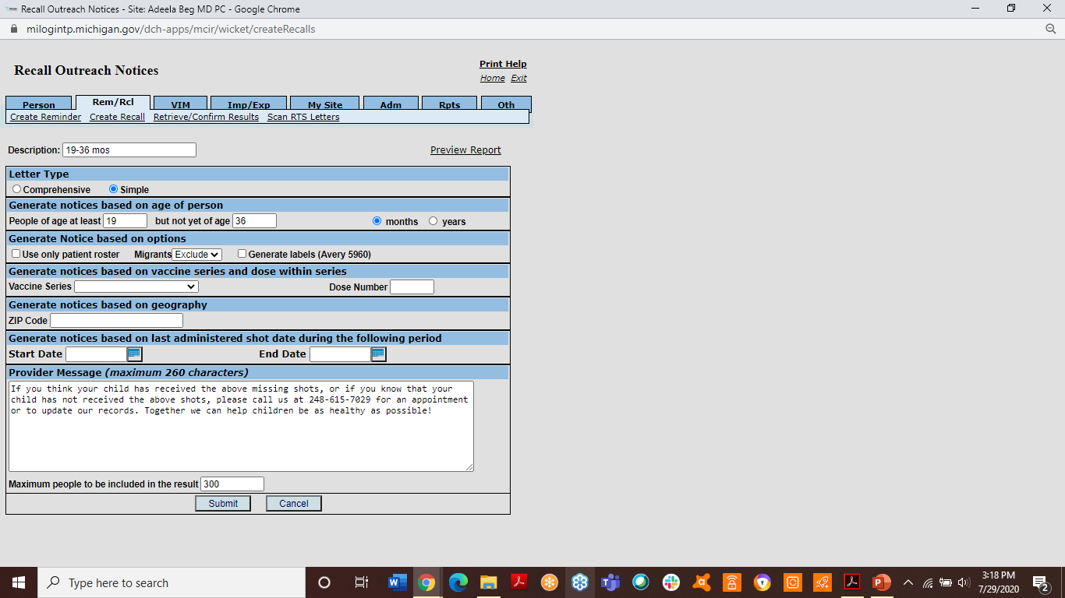
Recall Parameters
Change the Description to describe the type of Recall being run (Ex: 19-36 mos. Recall)
Choose between the Simple or Comprehensive Letter Type, then click the Preview button to view each letter
Notes:
At the top of the Recall Outreach Notices page is a description box. You’ll want to delete the letters and numbers in this box, replacing it with a title that identifies the recall.
For example, title your recall “19-36 Month Recall” if you’re running a general recall for that specific age range.

Slide 30
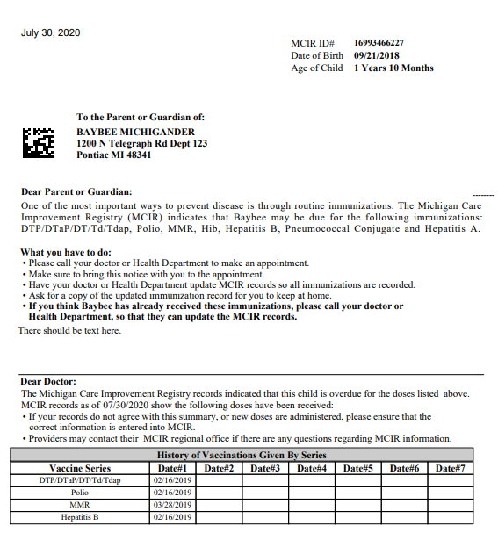
The Recall Letter – Simple Preview
Notes:
This is a Preview of a Simple Letter.

Slide 31
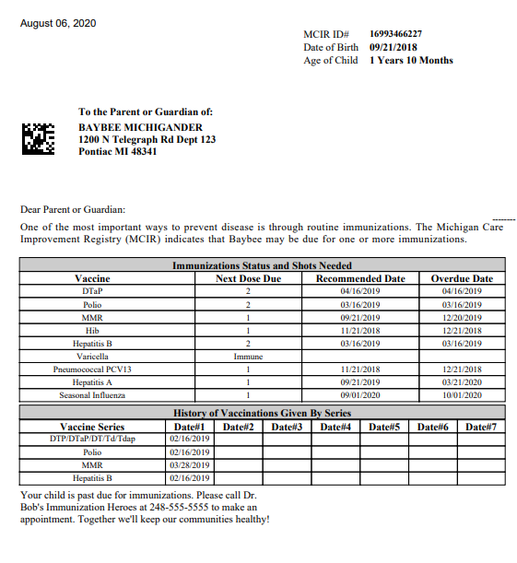
The Recall Letter – Comprehensive Preview
Notes:
This is a Preview of a Comprehensive Letter.

Slide 32
Recall Parameters
Add your age range (must be 6 months or older)
Choose the age in months or years
Notes:
One requirement for recall is choosing the age range, which must be a minimum of 6 months of age.

Slide 33
Recall Parameters - Options
Only choose Patient Roster if it’s being maintained
Only include Migrants if applicable
Labels can be generated to use on postcards
Leave options blank if none apply
Notes:
Options can be chosen or left blank

Slide 34
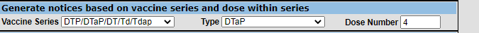
Recall Parameters -
If left blank, all overdue patients in the age range requested will be included
Vaccine Series and dose number can be chosen to identify patients overdue for specific vaccines (this can be helpful for using soon to expire vaccine)

Slide 35
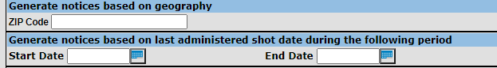
Recall Parameters
Recall can be run for patients living in specific zip codes
Notices can be run for a specific timeframe (based on the last administered shot date)

Slide 36
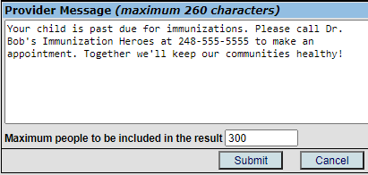
Recall Parameters
Add a Provider Message including your office name and phone number
Type the maximum number of recall letters to generate
Choose Submit to review a pop-up confirming the recall parameters
Notes:
Be sure to add your Office Name and phone number to your provider message, keeping it under the 260 character limit
Add the number of recall letters that you feel is manageable, then click the Submit button to review your recall parameters

Slide 37
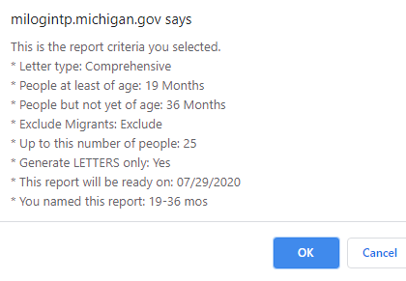
Recall Parameter Review
Review the pop-up showing your recall parameters, then click OK to Submit and return to the MCIR Landing Page
Click Cancel if changes need to be made to the parameters
Notes:
If everything looks good on the recall parameter review pop-up that appears, click OK
If you notice changes that need to be made before submitting, click Cancel to make the changes, then Submit to review again before clicking OK

Slide 38
Retrieving Reminder/Recall Results
After submitting the report, you’re taken back to the MCIR Landing Page
To see if the report is ready, click the Retrieve/Confirm Results link in the Reminder/Recall box to view the Reminder/Recall Runs Page
Notes:
The Results for a Reminder or Recall notice will need to be retrieved from the Reminder/Recall box on the MCIR Landing page, or the Rem/Rcl tab on any other page.

Slide 39
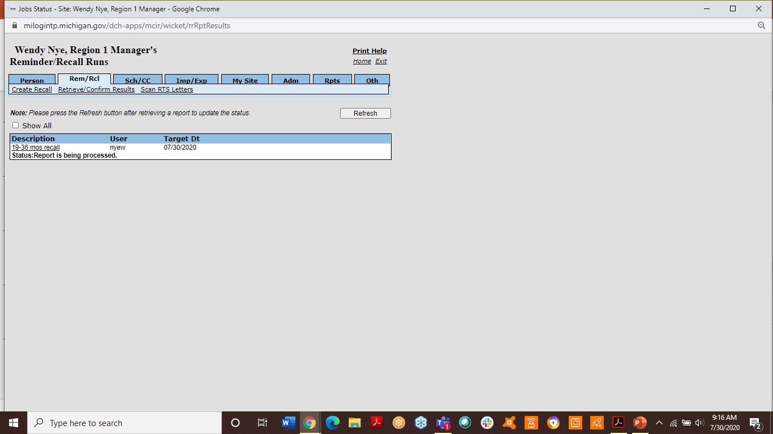
Reminder/Recall Retrieval Status
Reminder/Recalls take time to process (the Status is found under the Description)
Click the Refresh button to update the Status
Notes:
After submitting a reminder or a recall, it can take time for the report to process due to the number of letters you’re requesting (as well as the number of jobs submitted before it in the queue)
If remaining on the Reminder/Recall runs page, click on the Refresh button to update the Status
Status types include:
Report is being processed
No data found
Aborted
Waiting to be mailed

Slide 40

Retrieving the Reminder/Recall Report
Once the Status is Waiting to be mailed, click on the Retrieve Report link to see your results
Review the report, then print the results
Notes:
Once the report Status reads Waiting to be mailed, the report can be reviewed by clicking on the Retrieve Report link to the far right of the description
Review the report, especially the very last page that shows a summary of the Matched People who generated a letter, as well as the Non-Matched People that did not. Someone may appear under the Non-Matched Summary because MCIR was unable to find a record match (deceased person, bad address, etc.)
If the letters look good, they can be printed and folded to fit into a size 10 windowed business envelope

Slide 41
Confirming or Purging the Reminder/Recall Report
Once the letters are printed, it’s extremely important to edit and/or confirm the report as mailed
Close out of the letters pop-up, and click the Refresh button on the Reminder/Recall runs page to see additional options
Notes:
If the Reminder/Recall report is going to be used for outreach to the overdue patients, it’s important to mark it in MCIR as Mailed. This prevents additional recalls from being generated for the same patients for 60 days.
After closing out of the letters pop-up, additional choices will appear after clicking on the Refresh link.

Slide 42
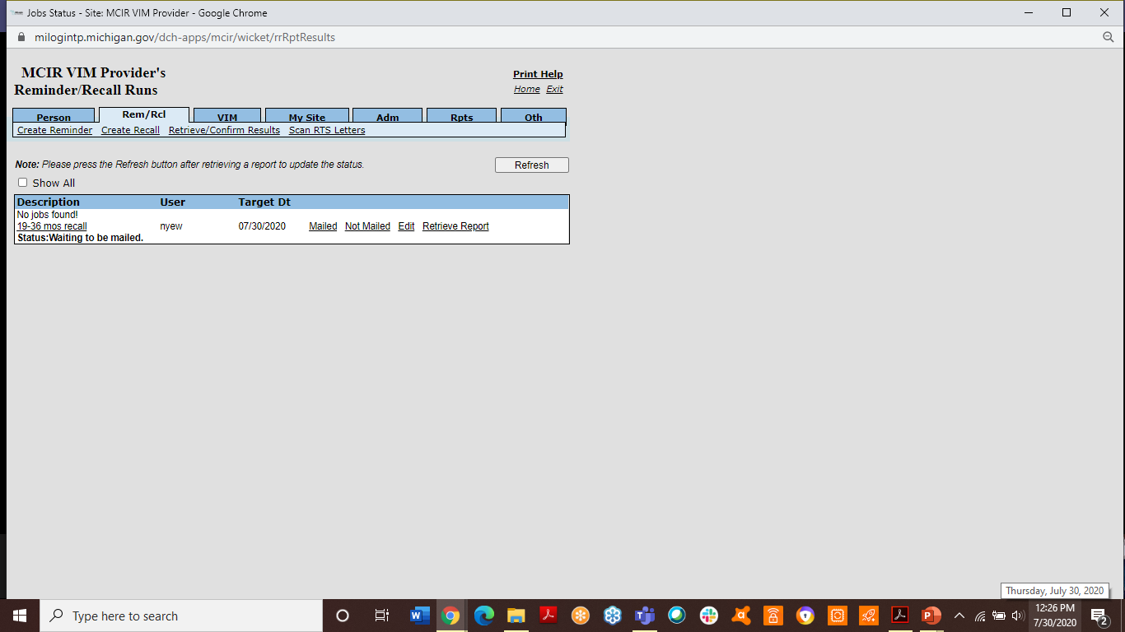
Confirming or Purging a Reminder/Recall Report
After Refreshing the Reminder/Recall Runs Page, additional options appear:
Once marked as Mailed or Not Mailed, the report will be permanently removed from the Reminder/Recall Runs page
Notes:
The options that appear after Refreshing page are:
Mailed – this link should be used after editing and printing the letters, to confirm the report and prevent additional recalls for 60 days
Not Mailed – this link should be used if the Recall results will not be used, purging the report as if it were never run
Edit – if a person needs to be removed from the report (maybe they have an appointment in the next few days), this link can be used to remove their name from the report confirmation (though their letter will need to be manually pulled after printing)
Just in case they don’t make their appointment, by editing them out of the results before marking the report as Mailed, they would be included in a subsequent recall right away
Retrieve Report – this link remains on the page, allowing you to retrieve the recall report until it is marked as Mailed or Not Mailed

Slide 43
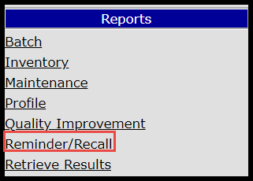
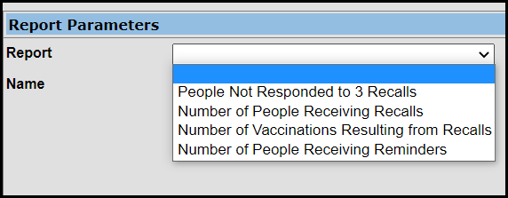
After sending the Recall
Reminder/Recall reports show information on how well people responded to the letters.
Allow for additional data clean up after patients don’t respond to three recalls.
Notes:
After the reminder/recalls have been sent there are reports available to see how many immunizations have resulted from the notices, and who has been sent three recall letters and not responded.
To view these reports from the MCIR Landing page, go to the Reports menu and select Reminder/Recall.

Slide 44
You now know the “HOW” to generate MCIR recall letters – let’s learn the “WHO”
The Michigan Immunization Quality Improvement (QI) Reports are available to practices/clinics using the Michigan Care Improvement Registry (MCIR). Several QI reports can assist to identify specific age cohorts and vaccines to generate Recall Letters for your practice. Using the QI reports can save time and assist with increasing responses from the mailed recall letters. For more information on using the Quality Improvement Reports for your practice or clinic contact the Immunization staff at your Local Health Department or the Michigan Immunization QI Coordinator at Sanchezs@michigan.gov
Notes:
Whether at a clinic, multi-physician practice, county, or state level, data helps drive your planning and intervention process. For HPV vaccination, knowing your data means determining baseline vaccination rates. Calculating your baseline rates of patients who have initiated and completed the HPV vaccine series is critical before beginning any intervention. Adolescent health care quality is measured by several Healthcare Effectiveness Data and Information Set (HEDIS) performance indicators important to payors. Improving HPV vaccination rates can impact organizational quality measures for immunization of adolescents and adolescent well-care visits.

Slide 45
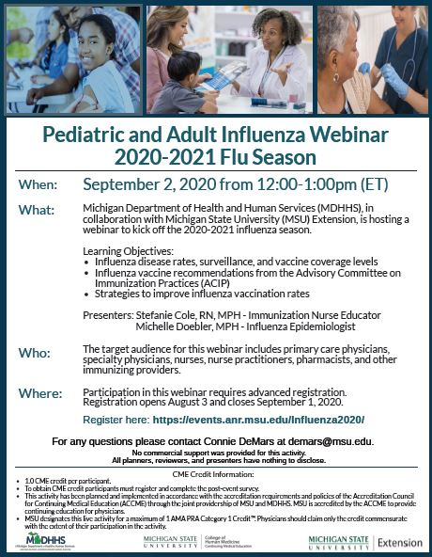
2020-21 Flu Webinar
September 2: 9th annual Pediatric and Adult Influenza Webinar 12:00-1:00pm (ET)
Registration is NOW OPEN and will remain open until September 1, 2020: https://events.anr.msu.edu/Influenza2020/
There is 1.0 CME credit available for physicians and nurses, also 1.0 PCE credit available for pharmacists
Participants that wish to watch the webinar as a group must still register individually to be eligible for CME/PCE credits
For questions, please contact Connie DeMars at demars@msu.edu

Slide 46
Questions?
Thank you!
Bea Salada, MDHHS MCIR Coordinator saladab@michigan.gov
Special thanks to the Regional MCIR Coordinator’s for their collaboration in the preparation of this presentation:
Region 1, Wendy Nye
Region 2, John Harwood
Region 3, Ashley Tate and
Kim Scott, MDHHS MCIR Education & Training Analyst

